Slide 1

E-commerce using python
Project by : Jillidimudi venkatesh
Reg no : 323233660019

Slide 2
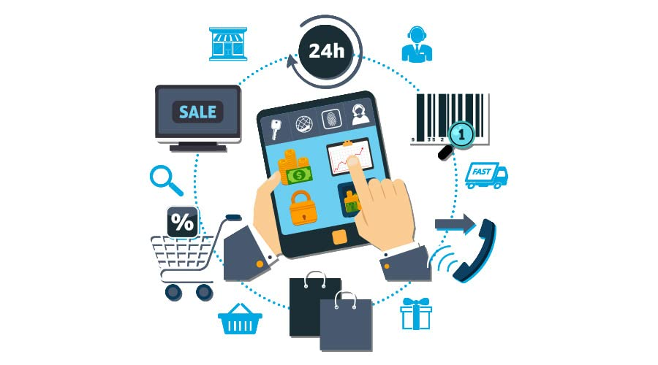
Introduction
Nowadays, people like to buy products online instead of going to shops, They want to shop anytime, from anywhere, using their computer or mobile, this project is a complete online shopping website called BuyNow e-commerce system.
• user registration and login
• browsing products with search and filter options
• adding products to a shopping cart
• admin dashboard to manage products and orders
• mail confirmation after placing order by user

Slide 3
Objectives
The objectives of this project are multi-faceted, covering both the technical and functional dimensions required to build a robust e-commerce platform.
User Authentication and Authorization : Implement secure registration & login,
Shopping Cart System : Allow customers to add, remove, and update product,
Payment method : Captures user input and confirms the purchase process,
Order Processing Workflow : Provide a seamless user experience from cart to checkout, including payment simulation, order confirmation,
Admin Dashboard : interface for administrators to manage products, users, orders, analytics,

Slide 4
Overview on the system
The system has three main parts :
Frontend – what the customer sees (HTML, CSS, JavaScript).
Backend – the logic and data processing (Python Django).
Database – stores information like products, users, and orders (SQLite3).
Who Uses It
Customers: can register, log in, browse products, add to cart, place orders, and check order history.
Admin: can add/edit/delete products, manage orders, and view reports about sales and customers.

Slide 5
Main Features
Secure login and account creation.
Product catalog with search and filter.
Shopping cart with live price update.
Checkout process with order confirmation.
Admin dashboard for shop management
Mobile-friendly and works on any device.
Goal
make online shopping simple and secure for customer.
Give business an easy way to their products online without high costa

Slide 6
Hardware requirements
the hardware requirement are categorized based on the target in development environments , deployment server , and end-user device specifications.
Processor : inter core i5 AMD equivalent, minimum 2.4GHz (quad-core recommended)
RAM : minimum 8 GB (16 GB preferred for running simultaneous services)
Storage : 500 GB HDD or 256 GB SSD (SSD preferred for I/O devices)
Graphic : integrated graphic sufficient ; no dedicates GPU required for backend/frotend development
Display Resolution : FULL HD (1920*1080) or higher recommended
Peripheral devices : Keyboard, mouse, webcam, etc

Slide 7
SOFEWARE REQUIREMENTS
3. Frameworks & LIbraries
Frontend : HTML5,CSS3,JAVASCRIPT
Backend: Django 3.2+(python frame work)
Database : SQLite3
Security:Django-crispy-forms,django-cors –Header,
Operation system
Development : windows 11,macOS or Linux
Server : Ubuntu Server 20.04 LTS or higher
2. DEVELOPMENT TOOLS
Code Editor : visual studio code /pycharm
Version control : Git with GitHub
Package Management : pip (for Python)
Database management SQLite3
4.Optional integrations
Web server : uWSGI
Email server : SMTP

Slide 8
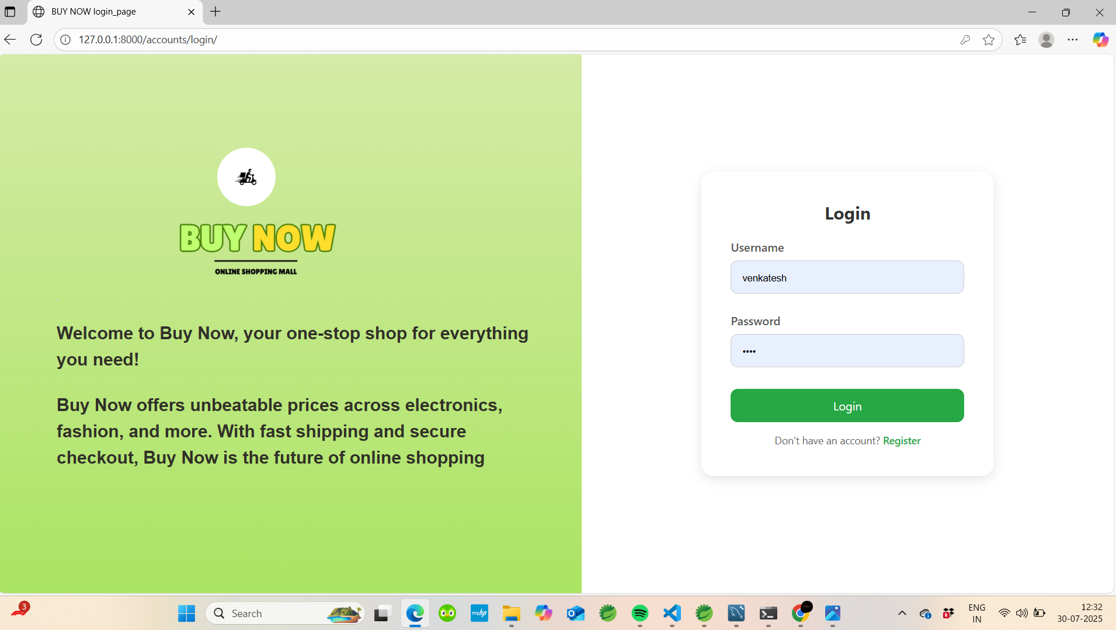
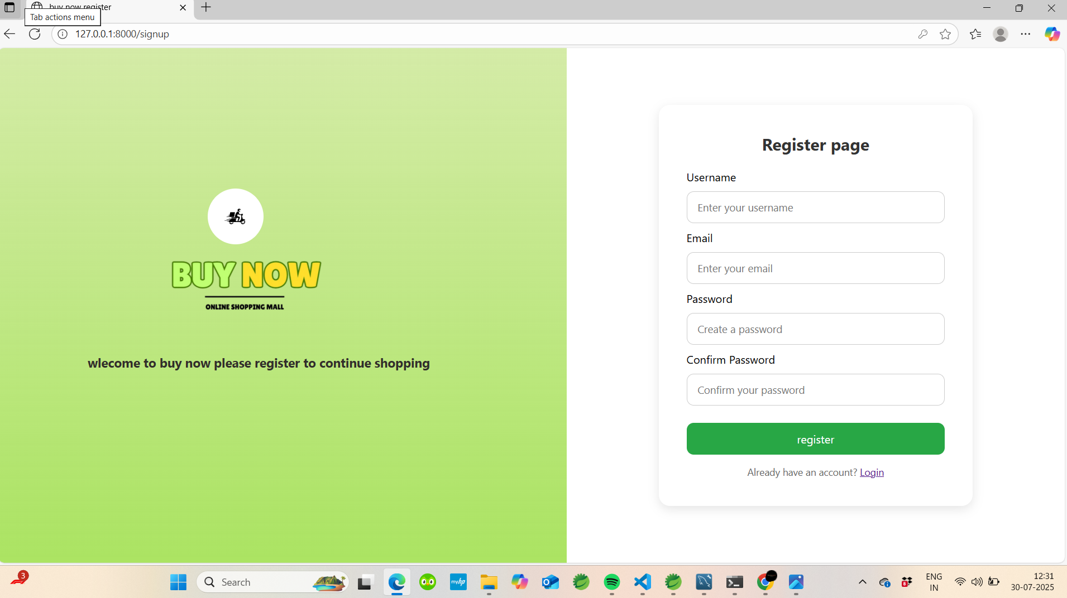
Output screens
1. Login page
2. Register page

Slide 9
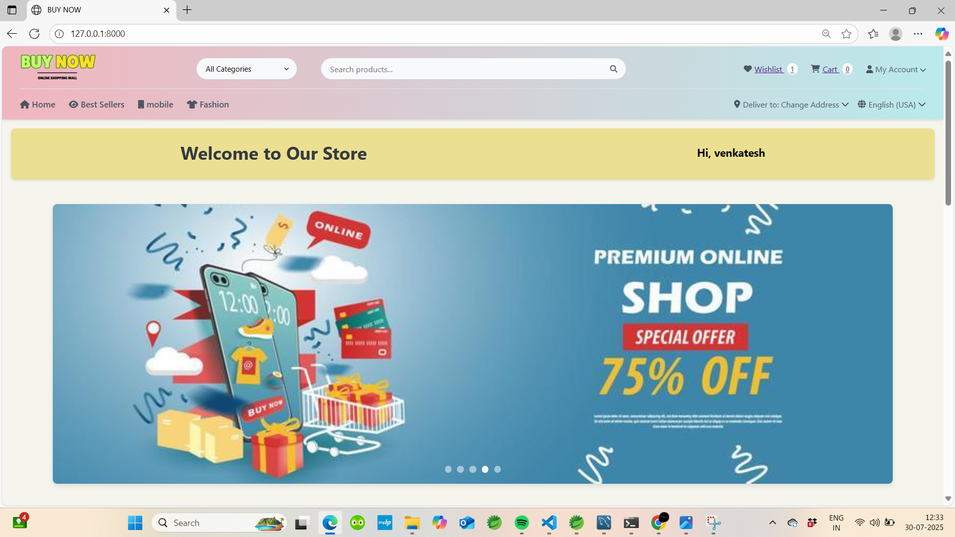
Title name
3. Home page
Categories filter
Search bar
User data
User profile
User name display
banner

Slide 10
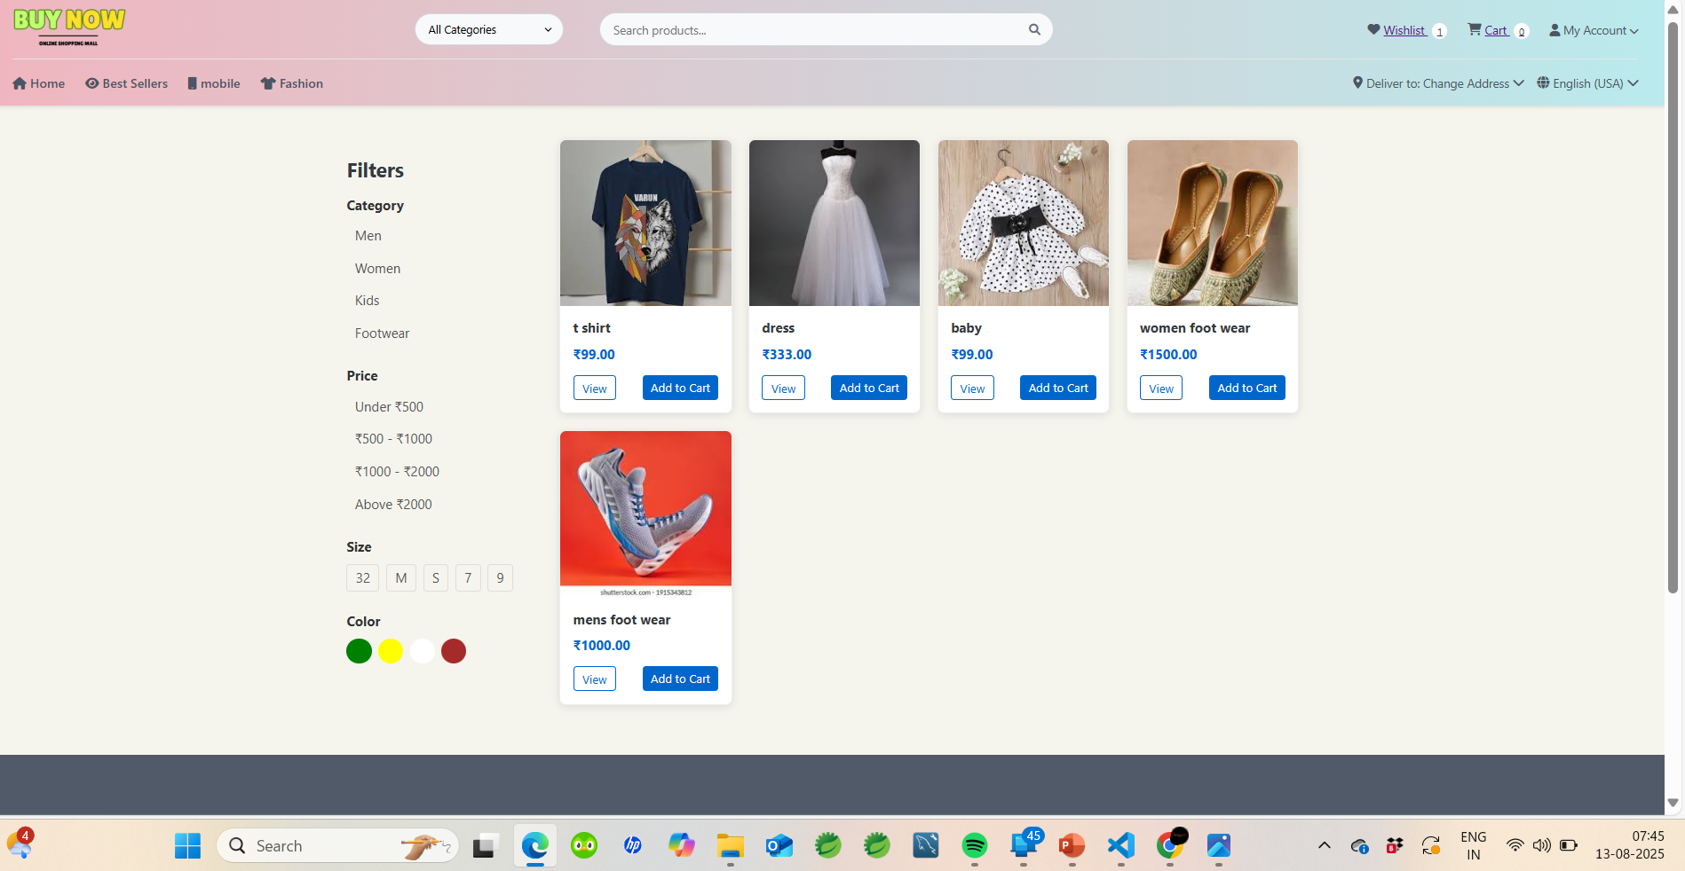
4.Product grid

Slide 11
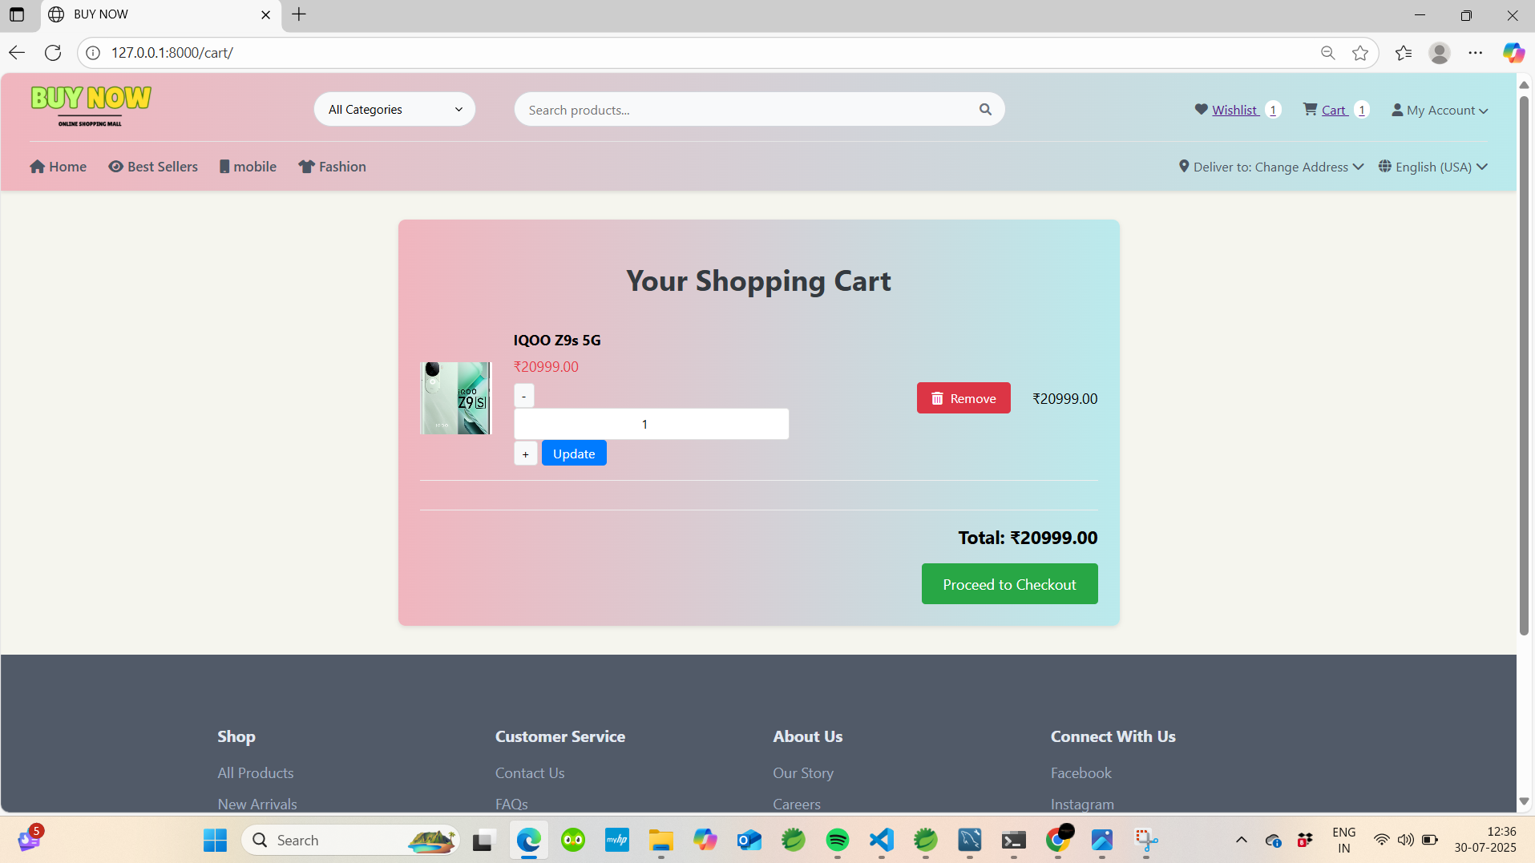
5.cart page

Slide 12
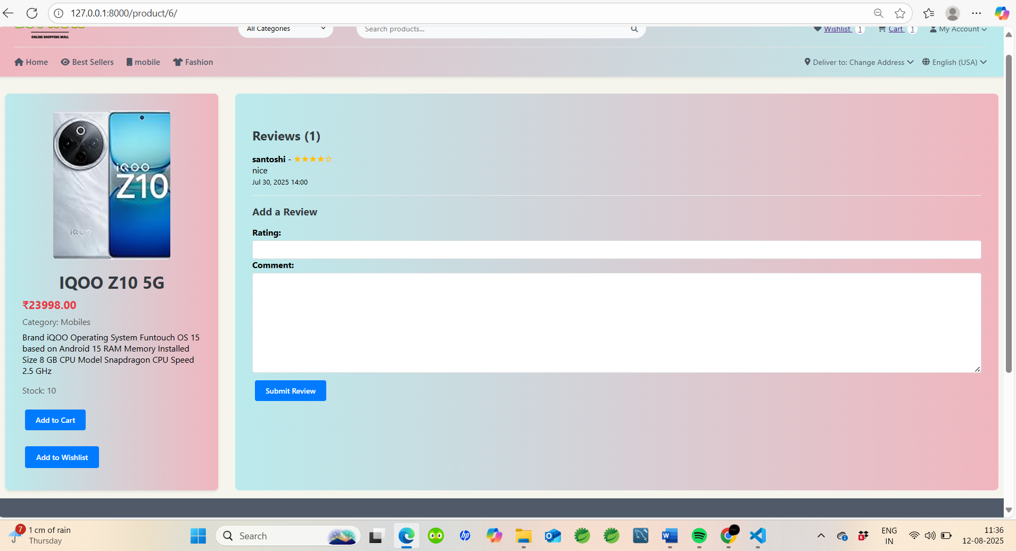
6. Product details

Slide 13
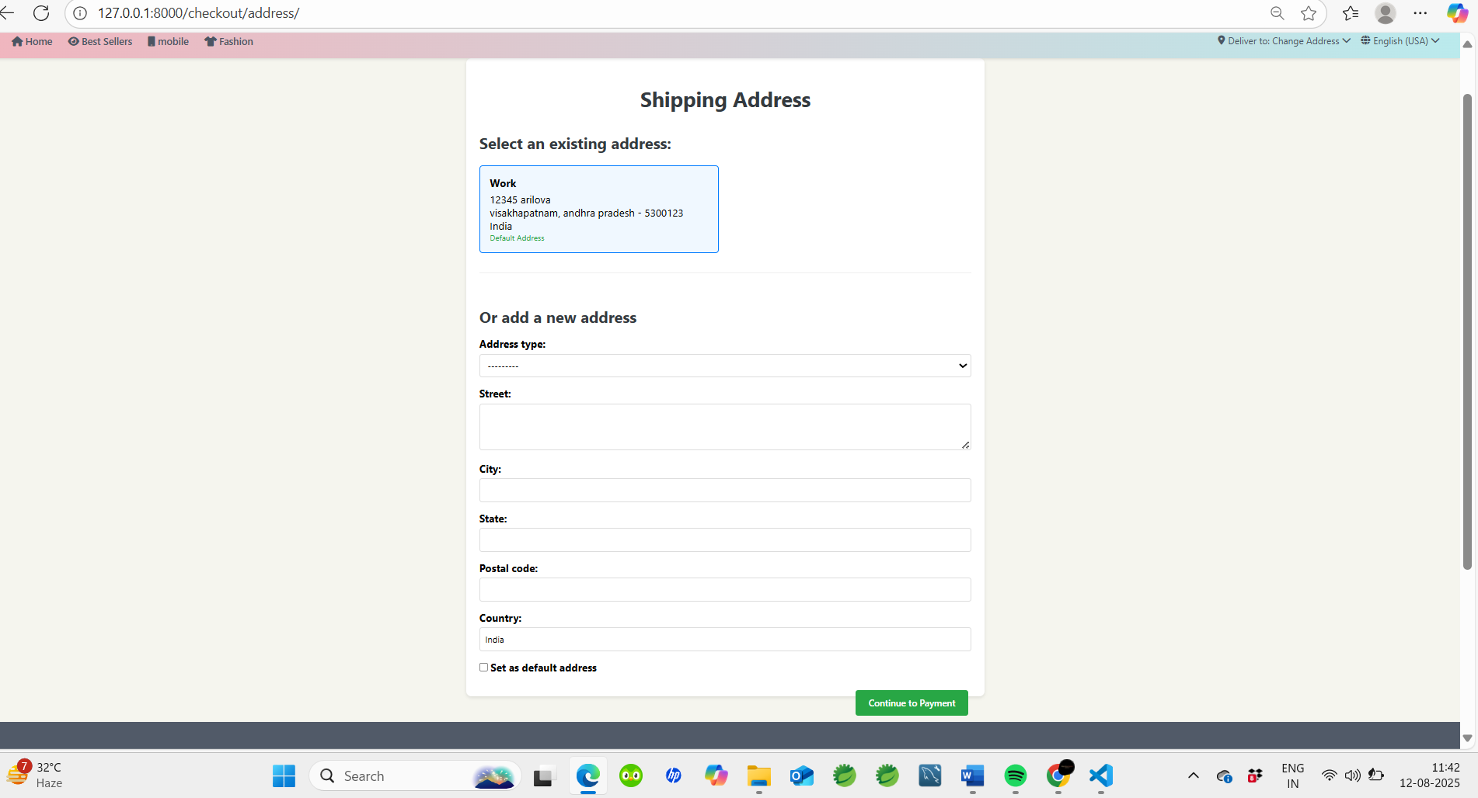
7.Shopping address

Slide 14
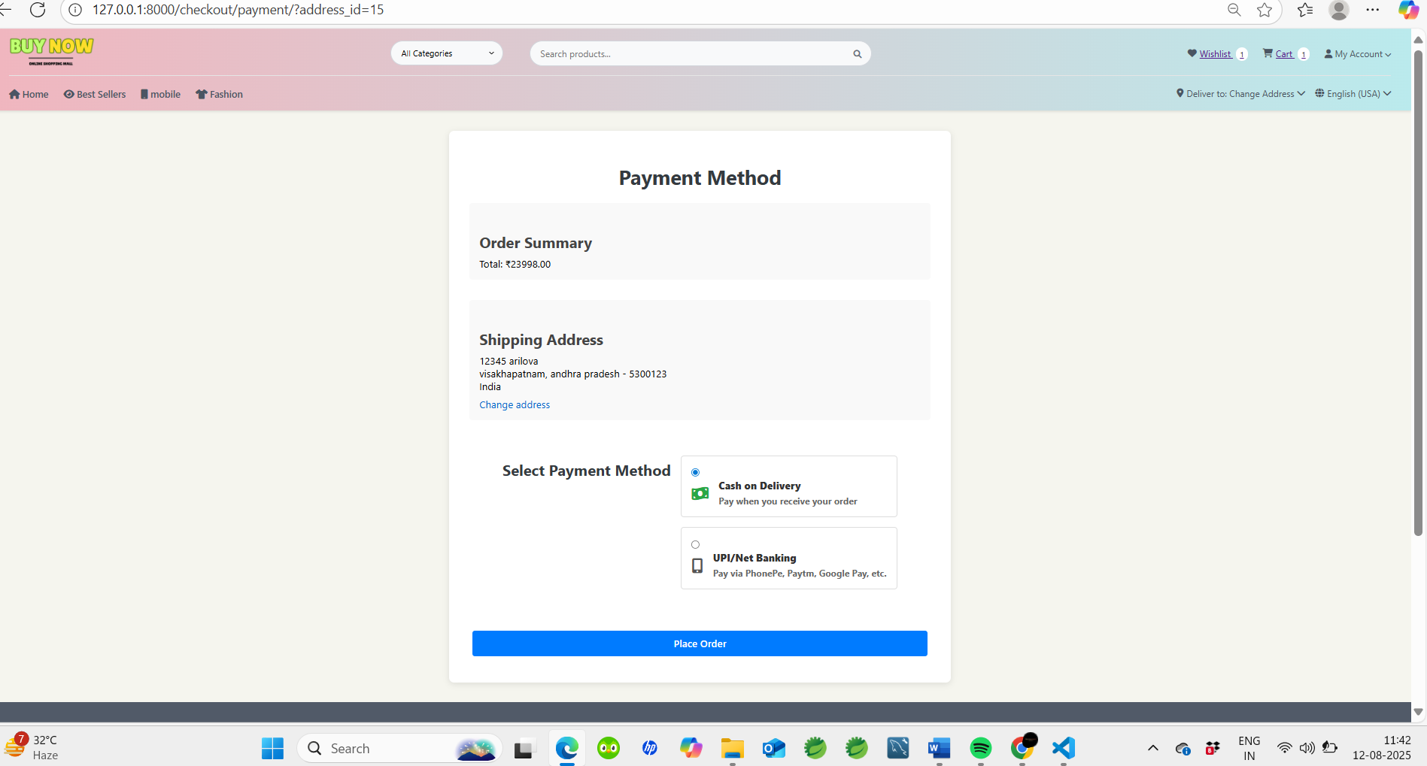
8.payment method

Slide 15
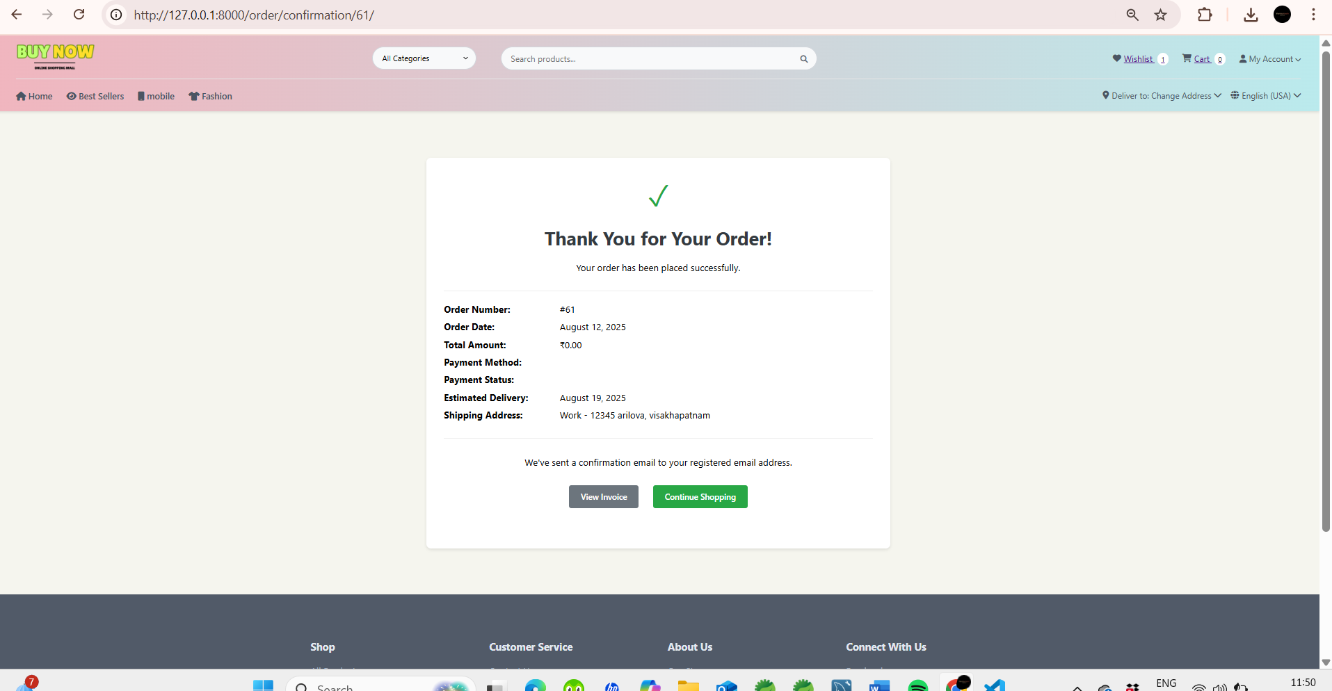
9.order confirmation

Slide 16
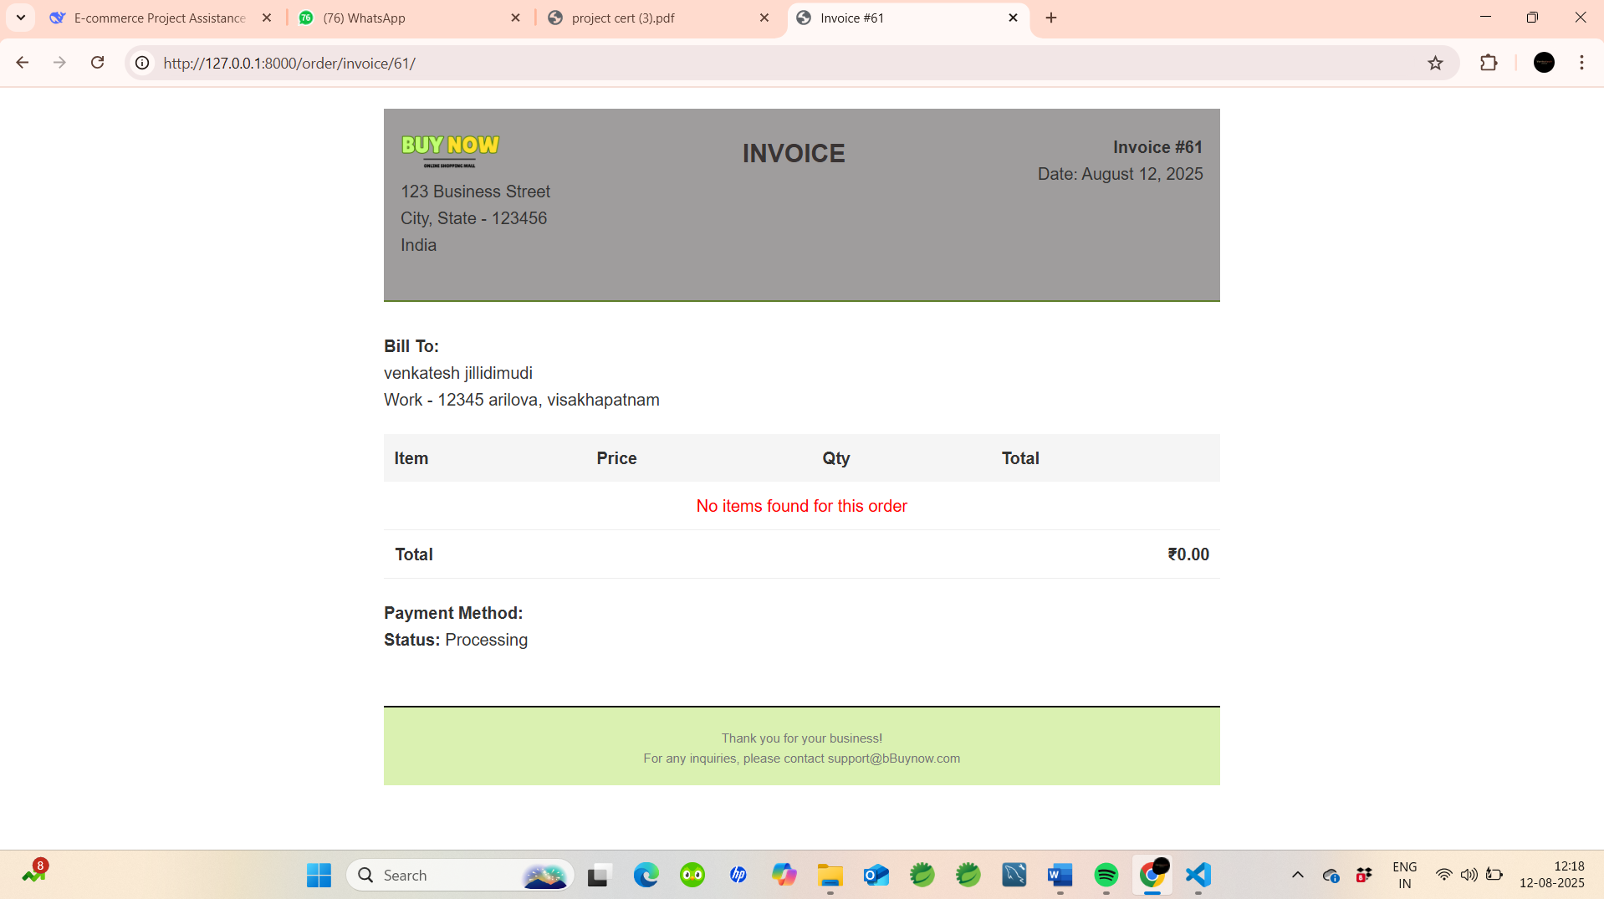
10. invioce

Slide 17
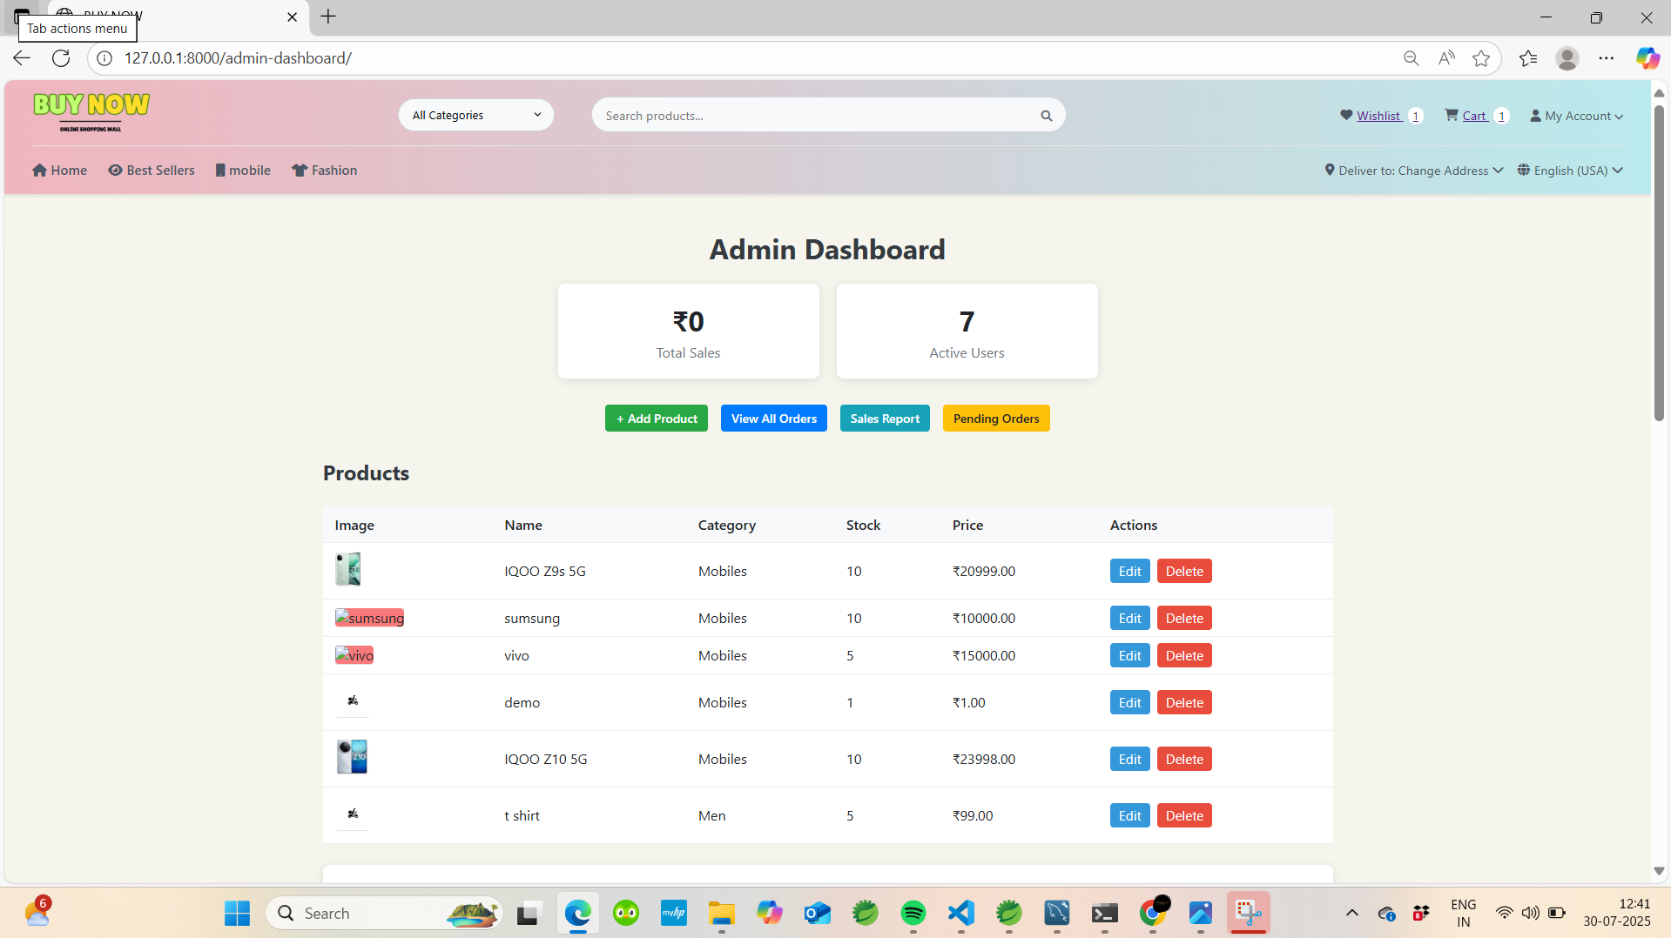
11.Admin page
total sale
Active user
Product control
All product

Slide 18
Conclusion The BuyNow E-Commerce System successfully delivers a complete online shopping platform with secure user authentication, product browsing, cart management, and admin control. Designed with Django, it provides a scalable and responsive solution for small and medium-sized businesses. Features such as filters, pagination, and a user-friendly interface ensure a smooth shopping experience. Strong focus on security, maintainability, and modular design for long-term use. Future enhancements include integration of online payment gateways, AI-driven recommendations, and advanced analytics for business insights.

Slide 19
THE END

